Slide 1
Geospatial API
Code Sprint 💻
15th-17th November, 2021

Slide 2

Agenda
Introduction
Overview of OGC API – Features
Overview of ISO 19168-1
Q & A

Slide 3


Brought to you by:

Slide 6
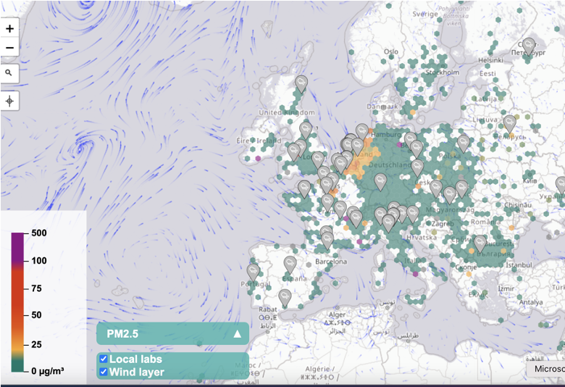
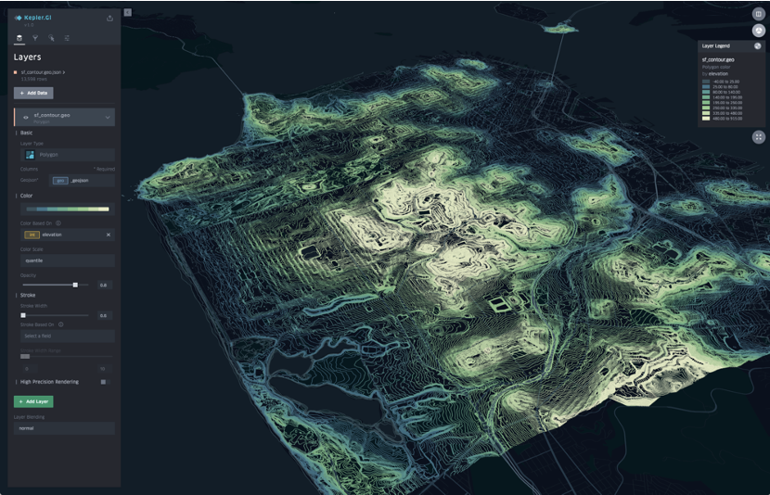
Motivation
The growing uptake of location within and beyond geospatial developer communities.

Slide 7




Modern Web APIs
APIs are a popular, effective method for rapid software development.

Slide 8
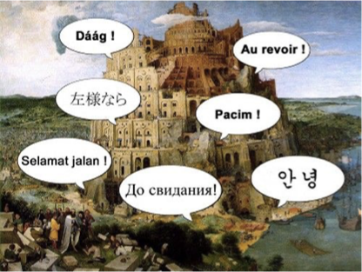
Interoperability
There is an increasing need for interoperability between Web APIs.

Slide 9

Welcome 👋
Geospatial API Code Sprint (15th-17th November)
A Code Sprint is a collaborative and inclusive event to support the development of new applications and open standards, as well as creating awareness about the standards.

Slide 10


Sprint Structure (2x speeds)
The sprint will take place on the Discord Server.
Main Track
General channels
Mentor Stream
Mentoring channels

Slide 11
Main Track
Developers will be working on their activities, at their own pace.
Discussion is encouraged at the #General channel (text), or at the #Breakout Room (voice).
We’ll meet at given checkpoints during the day, at the #Main Stage.

Slide 12
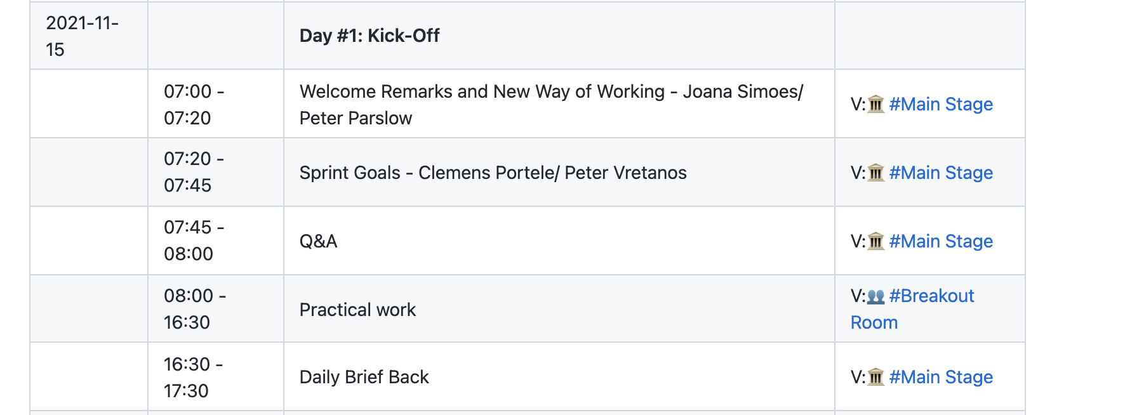
Day #1 - Monday, the 15th of November, 2021

Slide 13
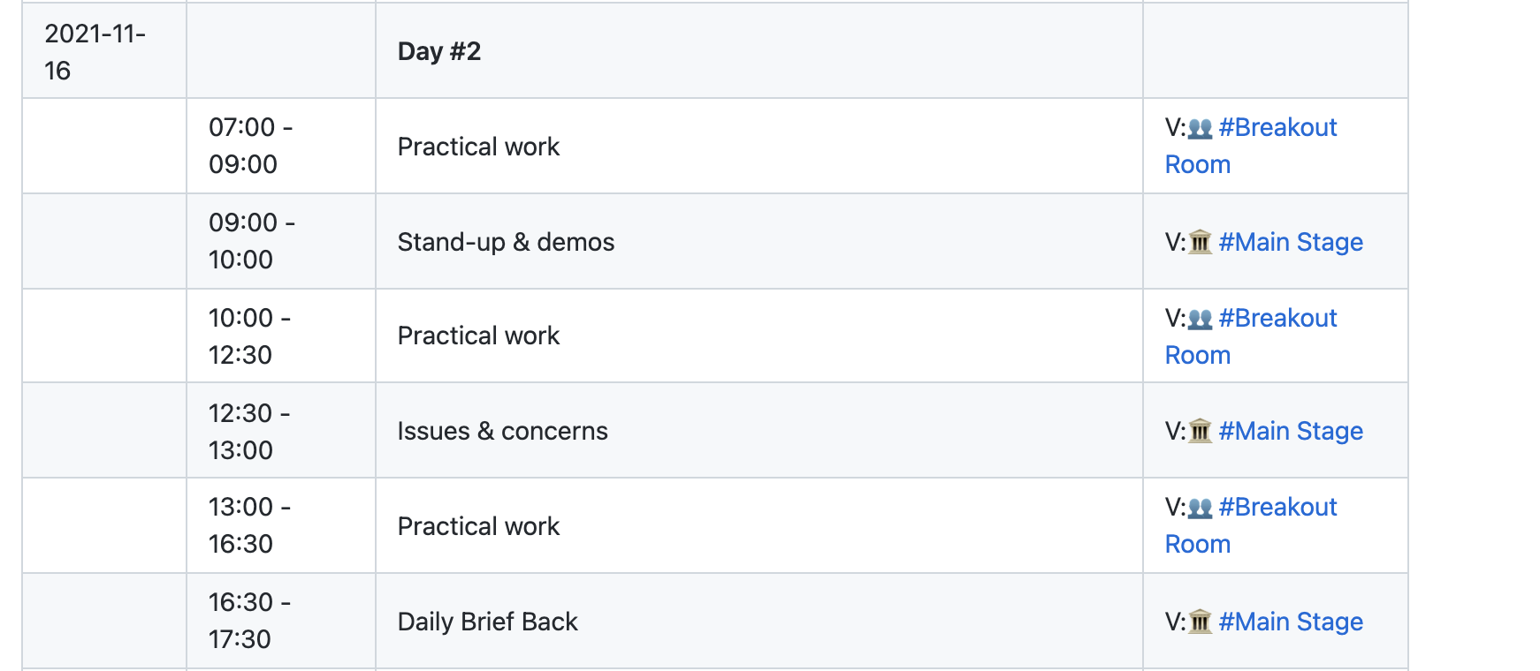
Day #2 - Tuesday the 16th of November, 2021

Slide 14
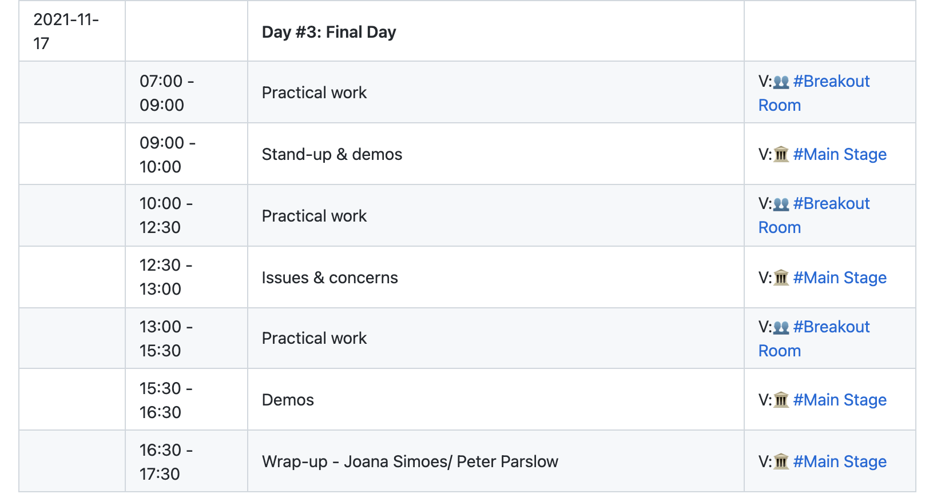
Day #3 - Wednesday, the 17th of November, 2021

Slide 15
Mentor Stream
Developers will have the opportunity to explore the standard.
Tutorials will take place at the #Mentor Room (voice).
We’ll make a curated dataset available for the sprint, after the first tutorial.
You can reach out to mentors on the #Mentor Room (text).

Slide 16
Tutorials 🎓
Monday, 10am-10:45am: Share your Data with OGC API Features
Tuesday, 10am-10:45am: Load feature data into your frontend application

Slide 17
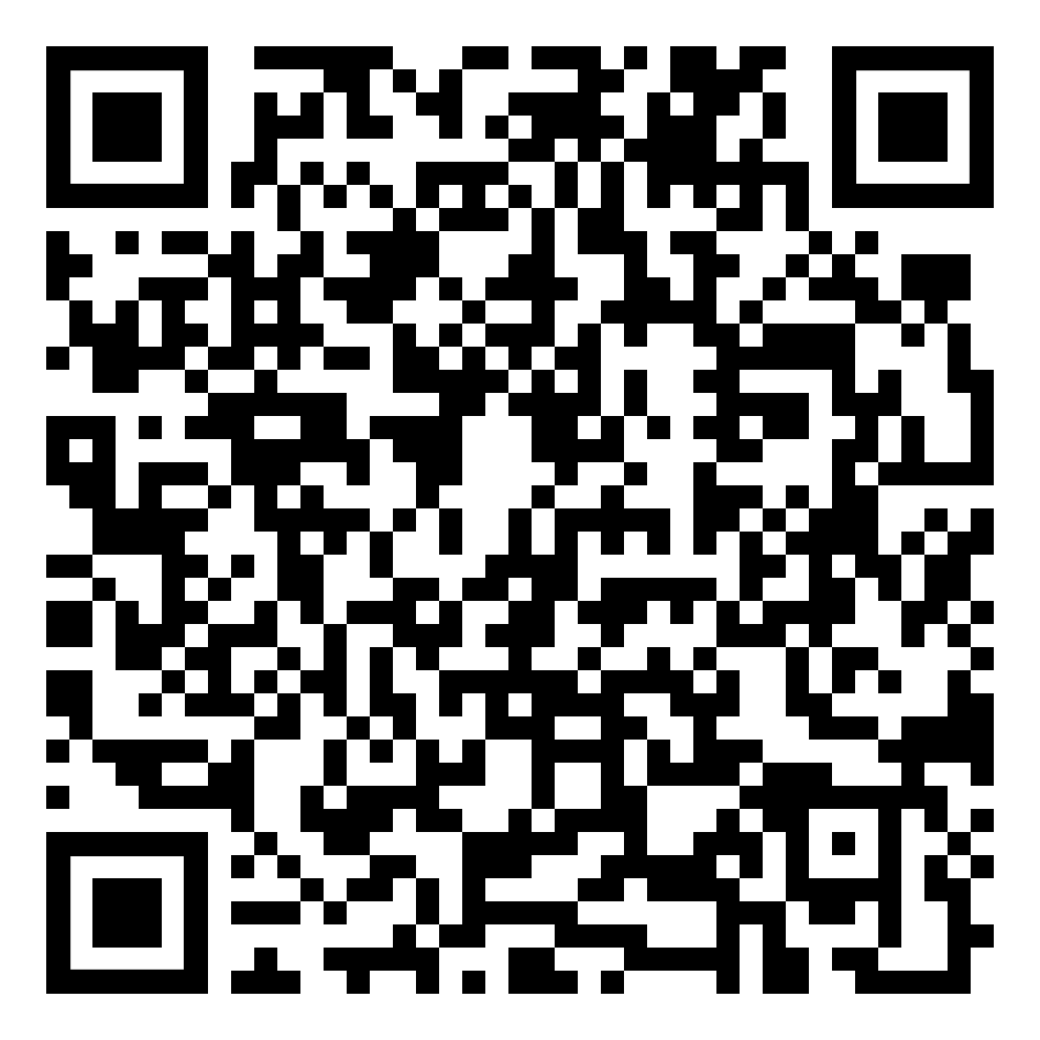
More information available at:
https://github.com/opengeospatial/developer-events/wiki/November-2021-Geospatial-API-Code-Sprint
https://tinyurl.com/geoapi

Slide 18

Overview of OGC API – Features

Slide 19
Overview of ISO 19168-1

Slide 20
Thank You
Community

